Slide 1
Class 3: Training a Simple Neural Network by Hand

Slide 2
Training a Neural Network by Hand
Today's goal: understand how NNs learn.
Walk through forward and backward passes.
Update weights over a few steps (epochs).
Manual learning = strong intuition for automation later.

Slide 3

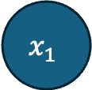
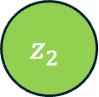
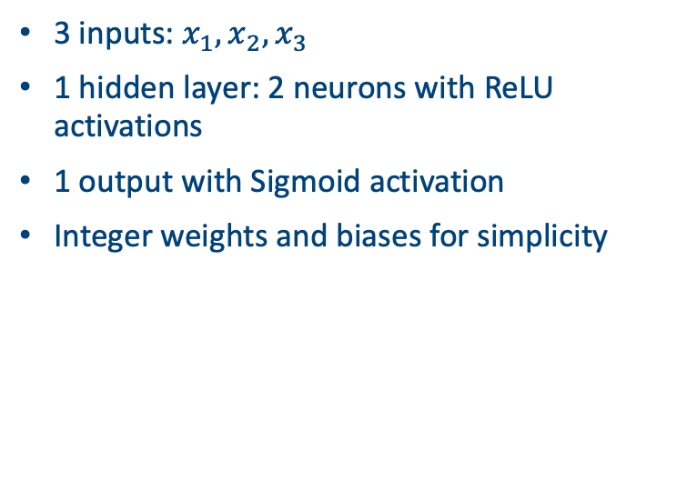
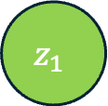

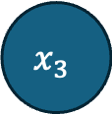

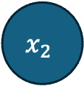

The Network Structure 3-2-1
$$x_{1}$$
$$h_{1}=ReLU(z_{1})$$
$$z_{1}$$
3 inputs: $x_{1}, x_{2}, x_{3}$
1 hidden layer: 2 neurons with ReLU activations
1 output with Sigmoid activation
Integer weights and biases for simplicity
$$x_{2}$$
$$z_{o}$$
$$z_{2}$$
$$\hat{y}=σ(z_{o})$$
$$x_{3}$$
$$h_{2}=ReLU(z_{2})$$

Slide 4



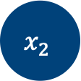






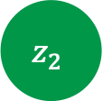





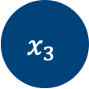


Now with weights!
$$x_{1}$$
$$w_{11}$$
$$h_{1}=ReLU(z_{1})$$
$$w_{21}$$
$$z_{1}$$
$$w_{o1}$$
$$+b_{o}$$
$$w_{12}$$
$$+b_{1}$$
$$x_{2}$$
$$z_{o}$$
$$w_{22}$$
$$+b_{2}$$
$$w_{o2}$$
$$w_{13}$$
$$z_{2}$$
$$\hat{y}=σ(z_{o})$$
$$w_{23}$$
$$x_{3}$$
$$h_{2}=ReLU(z_{2})$$

Slide 5
Input and Target
One input vector: [1, 0, 1]
Target output (label): 1
So this is a classification model
Goal: network output should approach 1 over time
On the board: for given weights and biases compute the forward pass

Slide 6
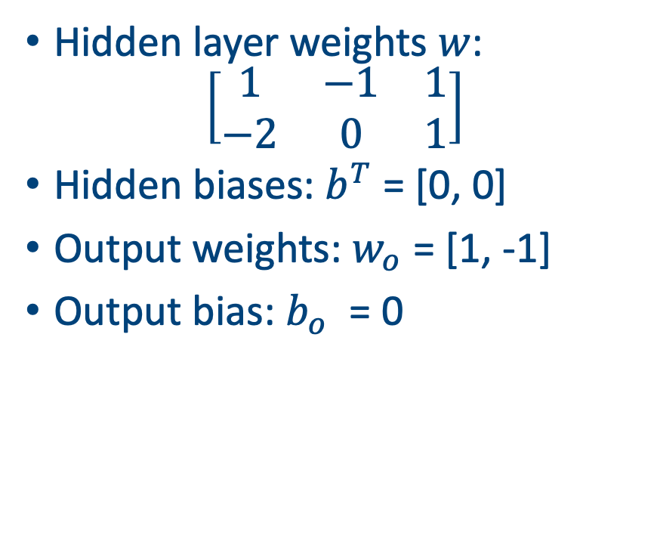
Initialize Weights and Biases
Start with all weights small, but helpful if they’re non-zero.
All biases = 0.
Will update over training using error signal.
Small integers make learning interpretable.
Hidden layer weights $w$:
$$\left[\begin{matrix}1 & −1 & 1 \\ −2 & 0 & 1\end{matrix}\right]$$
Hidden biases: $b^{T}$ = [0, 0]
Output weights: $w_{o}$ = [1, -1]
Output bias: $b_{o}$ = 0

Slide 7

Compute Loss
Use Binary Cross-Entropy:
$$L = −[y log⁡(\hat{y}) + (1−y) log⁡(1 −\hat{y})]$$
Compare network output to target label.
Loss is high if output far from target.
Loss tells us how ‘wrong’ the current weights and biases are.
Loss is high → backpropagation needed.
We will now update weights.

Slide 8
Now perform backpropagation
Compute error at the output layer.
Adjust output weights to reduce the error.
Propagate error backward to hidden layer.
Weights are updated to reduce future errors.

Slide 9
Overall algorithm
Initialize all weights and biases (e.g., to 0 or small integers). 2. For each epoch: a. Forward pass: i. Compute hidden layer pre-activations: z₁ = w₁·x + b₁, z₂ = w₂·x + b₂ ii. Apply ReLU activation: h₁ = ReLU(z₁), h₂ = ReLU(z₂) iii. Compute output layer input: zₒ = wₒ·h + bₒ iv. Apply Sigmoid activation to get prediction: ŷ = σ(zₒ) b. Compute Loss: i. Use Binary Cross-Entropy: L = -[y·log(ŷ) + (1−y)·log(1−ŷ)] c. Backward pass: i. Compute gradient of loss with respect to output weights ii. Backpropagate error to hidden weights only if ReLU > 0 d. Update parameters: i. Adjust weights and biases with gradient steps ii. Stop after desired number of epochs
On the board: go through all the steps!

Slide 10
Summary of Epoch 1
Forward pass completed with initialized weights.
Loss computed from output prediction.
Backward pass adjusted weights toward target.
Epoch 1 results in noticeable parameter changes.

Slide 11
Epoch 2 – Forward Again
Run forward pass with updated weights.
Compute new hidden activations and output.
Expect output closer to target = 1.
ReLU and Sigmoid continue to change values.
Go through epoch 2 on the board.

Slide 12
Summary of Epoch 2
Output moved closer to 1.
Loss dropped compared to Epoch 1.
Learning rate was effective.
Track all parameter values again.

Slide 13
Compare Epochs – Learning Trace
Usually we display outputs of loss function over epochs
Can also show weight evolution side-by-side.
Biggest changes usually in early epochs.
Later epochs just refine the pattern.
(wandb package useful for monitoring runs)

Slide 14
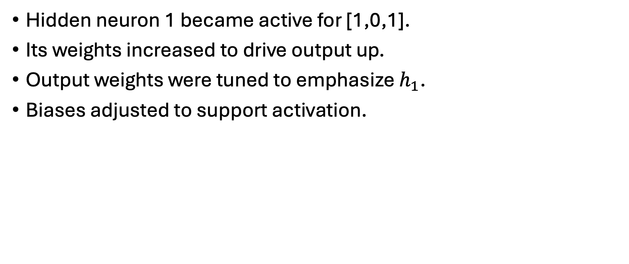
Summary – What the Network Learned
Hidden neuron 1 became active for [1,0,1].
Its weights increased to drive output up.
Output weights were tuned to emphasize $h_{1}$.
Biases adjusted to support activation.

Slide 15
Common Mistakes (By Hand and Code)
Forgetting to apply bias before activation.
Mislabeling the sign of gradient updates.
Applying activation at wrong stage.
ReLU 'zero-out' not handled correctly.

Slide 16
Practice Suggestions
Change input: try [0,1,1] or [1,1,1].
Try other initial weights and compare convergence.
Use two training examples.
Try tanh activation instead of ReLU.
A simpler version to this (with derivatives given) will be on the exam!

Slide 17
Summary
It’s a lot of work (and fiddly calculation) to go through a full forward and backward pass of even a simple NN
All the calculations though are pretty straightforward
Easy to make small mistakes. Marks given for process not accuracy

